Slide 1
IMAGE CORRECTION

Slide 2
Set theory is a branch of mathematical logic that studies sets, which informally are collections of objects. Any type of object can be collected into a set.

Slide 3
Combinations and Permutations When the order doesn't matter, it is a Combination. When the order does matter it is a Permutation.
My fruit salad is a combination of apples, grapes and bananas" We don't care what order the fruits are in, they could also be "bananas, grapes and apples" or "grapes, apples and bananas", its the same fruit salad.
"The combination to the safe is 472". Now we do care about the order. "724" won't work, nor will "247". It has to be exactly 4-7-2.

Slide 4
n! ------------------- (n − r)! where n is the number of things to choose from, and we choose r of them, no repetitions, order matters.
How many ways can first and second place be awarded to 10 people?
10! | = | 10! | = | 3,628,800 | = 90
(10-2)! |  | 8! |  | 40,320

Slide 5
Math can get amazingly complicated quite fast. Graph Theory, Abstract Algebra, Real Analysis, Complex Analysis, Linear Algebra, Number Theory, and the list goes on. But there is one thing that all of these share in common: Sets.

Slide 6
Subsets When we define a set, if we take pieces of that set, we can form what is called a subset. Example: the set {1, 2, 3, 4, 5} A subset of this is {1, 2, 3}. Another subset is {3, 4} or even another is {1}, etc. But {1, 6} is not a subset, since it has an element (6) which is not in the parent set.

Slide 7
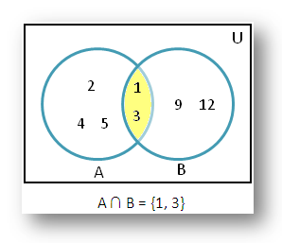
Intersection The intersection of two sets has only the elements common to both sets.

Slide 8
INTERSECTION
B
A

